Slide 1



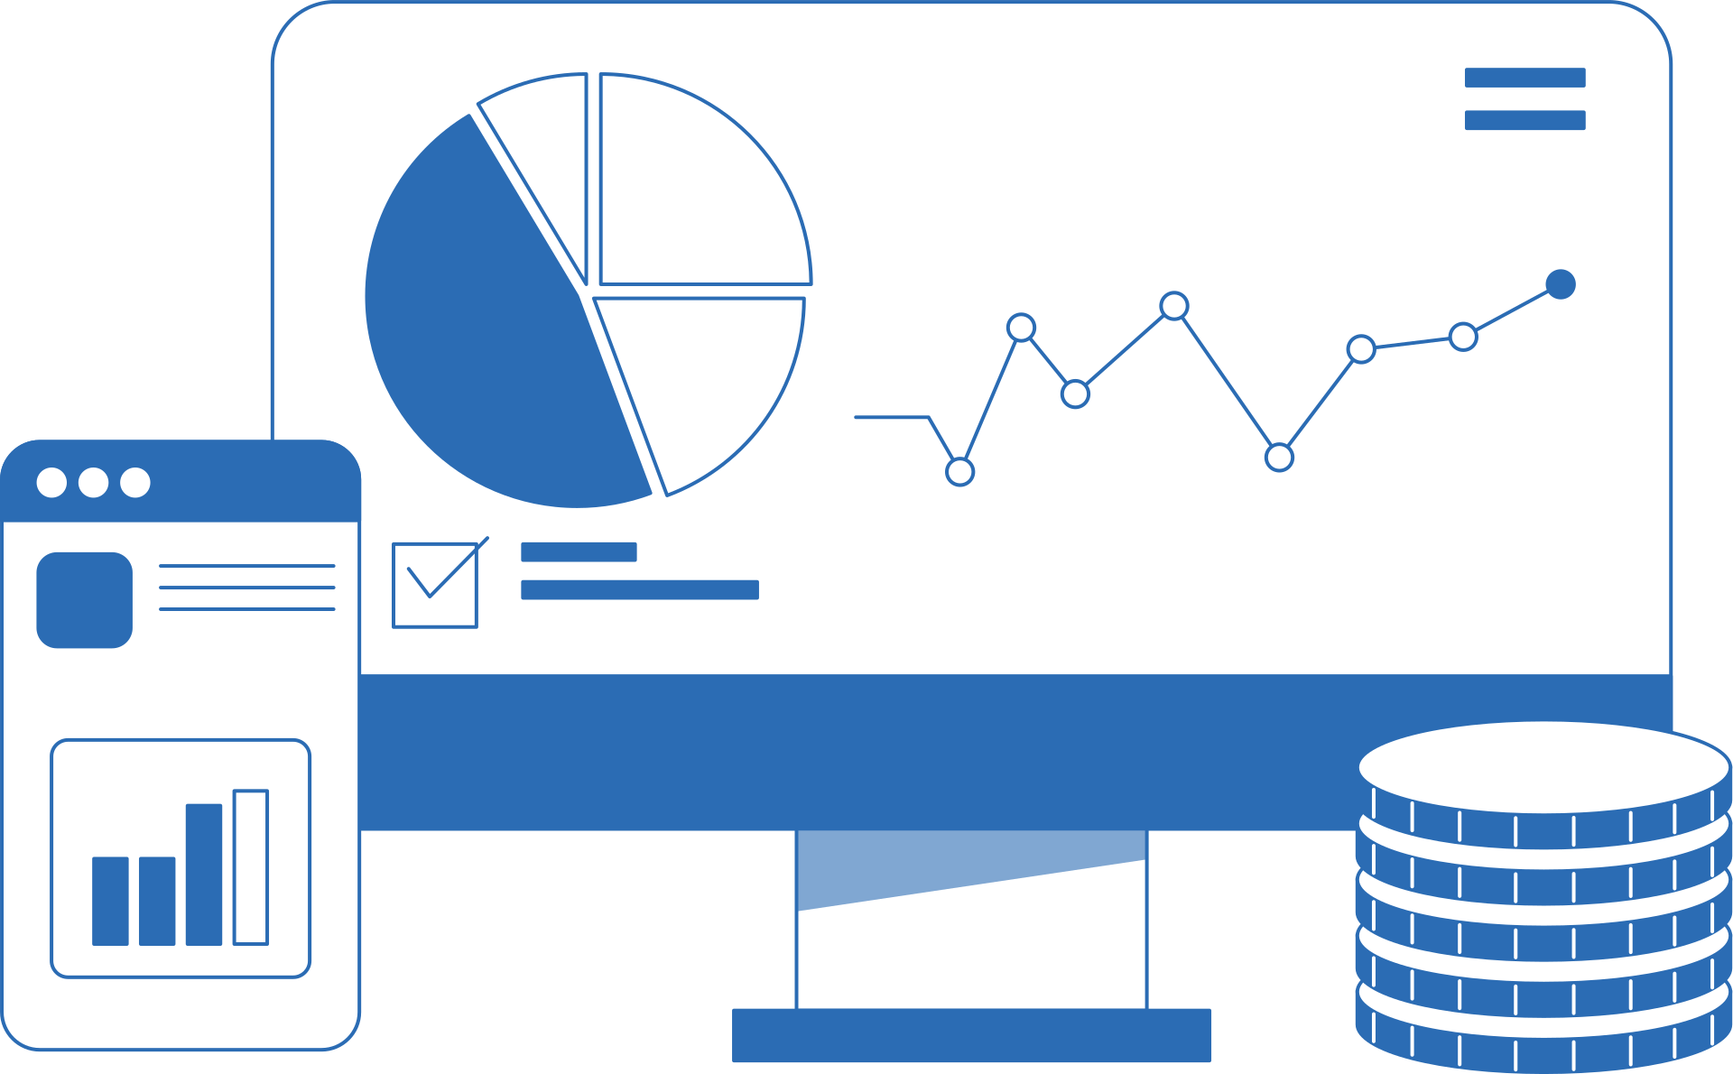

Page 001
Team 2
Supply
chain
Insights

Slide 2
Team Members
Page 002
AlaaHassan
Mariam Alaa
Sara Tawfik
Kyrillos Nassar
Marwan Ayman

Slide 3

Content
Page 003
Supply Chain
Overview
Dashboard
Analysis
This section provides a general overview of the supply chain operations and the key performance indicators used to measure efficiency. It highlights essential aspects such as inventory levels, order fulfillment, and overall operational performance to give a clear understanding of how the supply chain functions.
This section focuses on analyzing the data presented in the dashboard to identify patterns, evaluate logistics performance, and support data-driven decision making. The insights help stakeholders improve operational efficiency and optimize supply chain processes.

Slide 4


Page 004
Project
Overview
This project presents a supply chain dashboard designed to provide a comprehensive overview of key operational activities and performance indicators across the supply chain process. The dashboard integrates and visualizes data related to inventory management, order fulfillment, transportation, and overall logistics performance. By organizing this information into clear and interactive visuals, it allows users to quickly understand how different parts of the supply chain are performing.
The dashboard aims to support better monitoring and analysis of supply chain operations by highlighting important trends, patterns, and performance metrics. Through these insights, users can identify potential inefficiencies, evaluate operational performance, and gain a deeper understanding of supply chain dynamics. Overall, the project demonstrates how data visualization can transform complex operational data into meaningful insights that help support more informed and strategic decision-making.

Slide 5
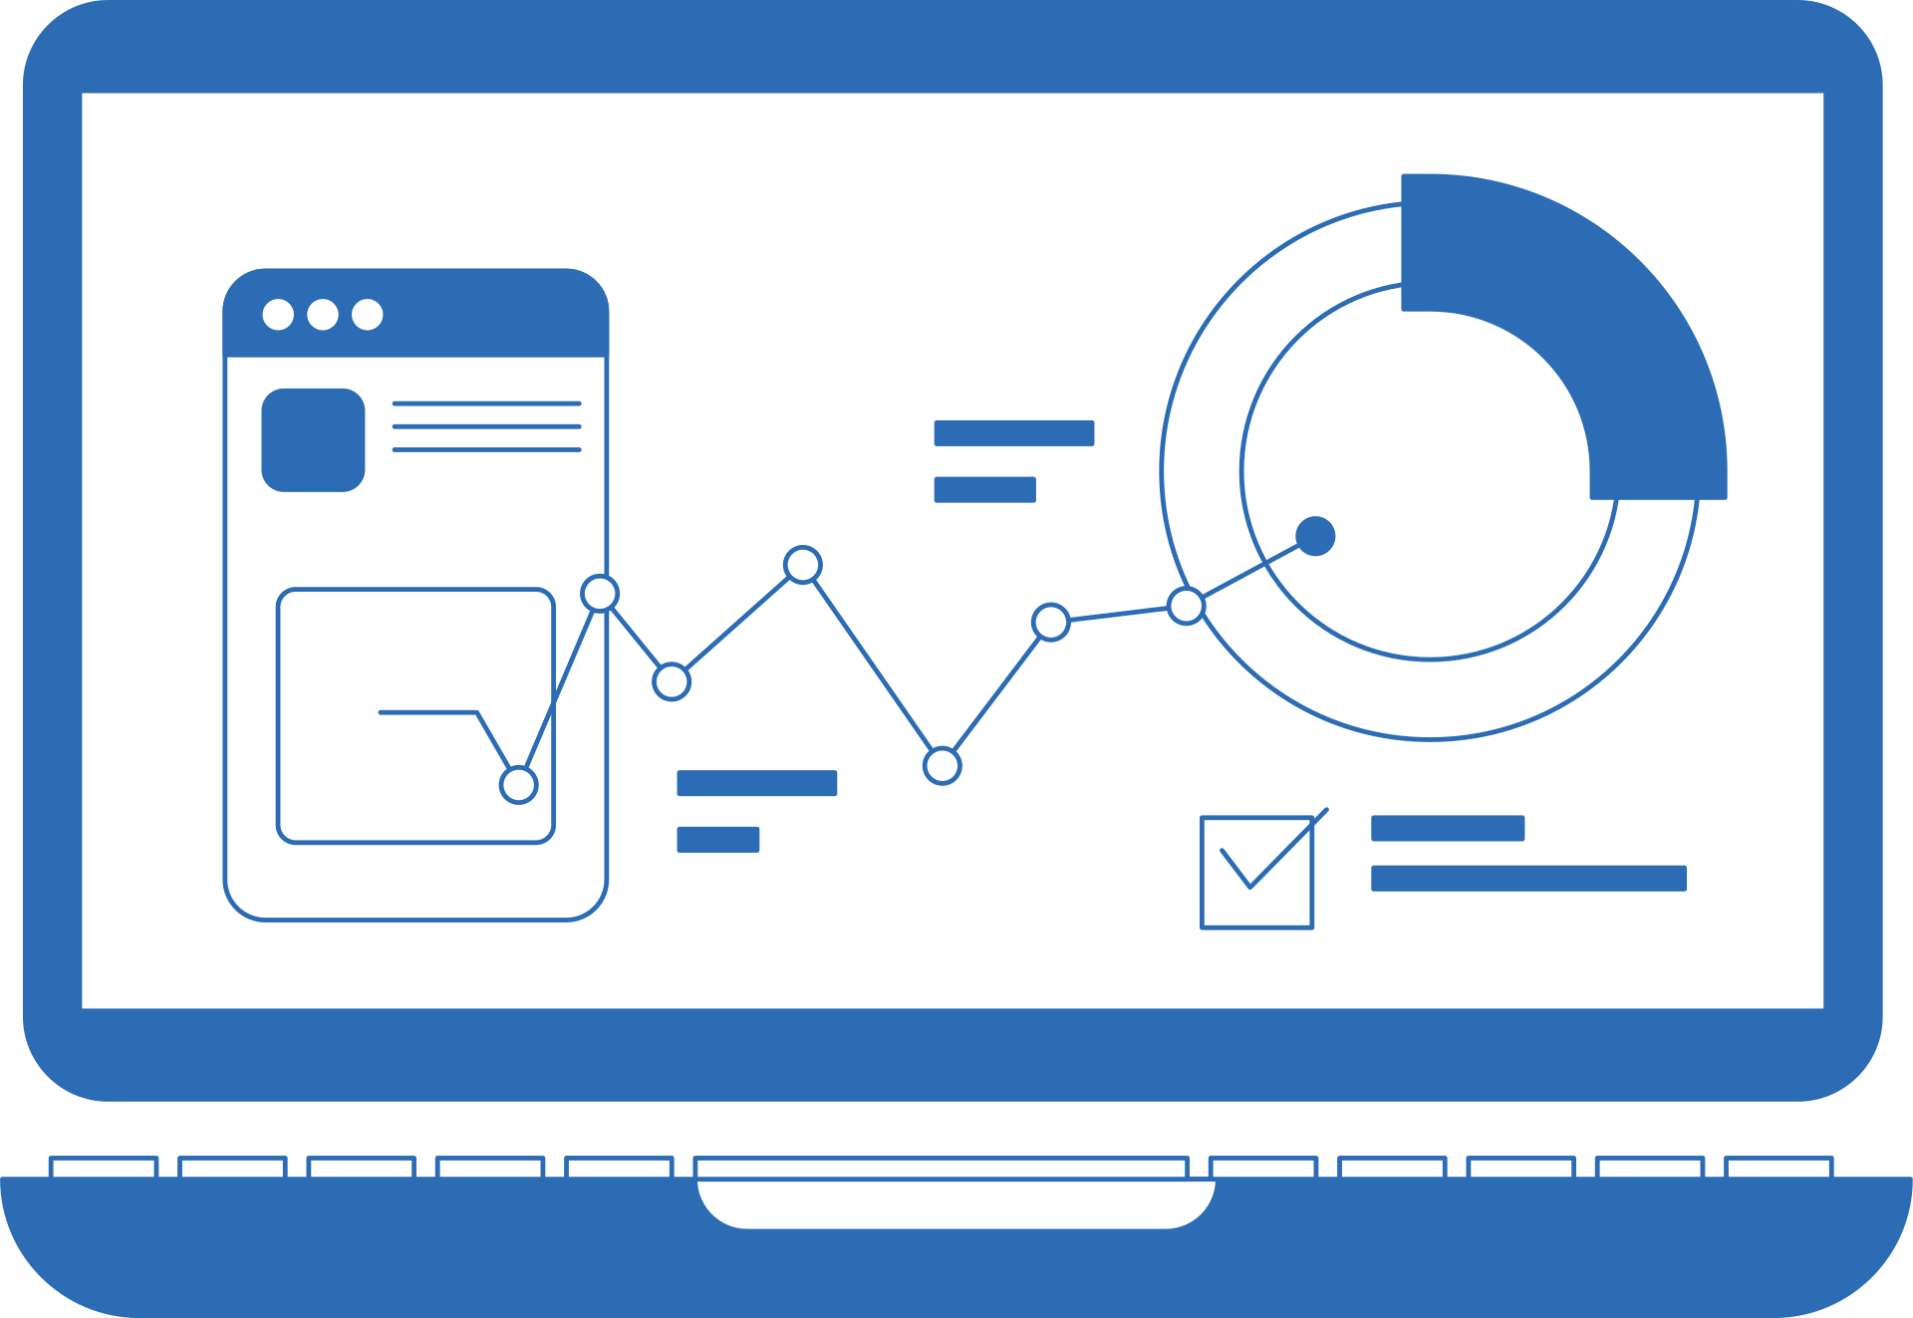
Page 005
Analysis
Data QC
Steps
Data Cleaning
Data Modeling
----------------
-----------------
-----------------

Slide 6
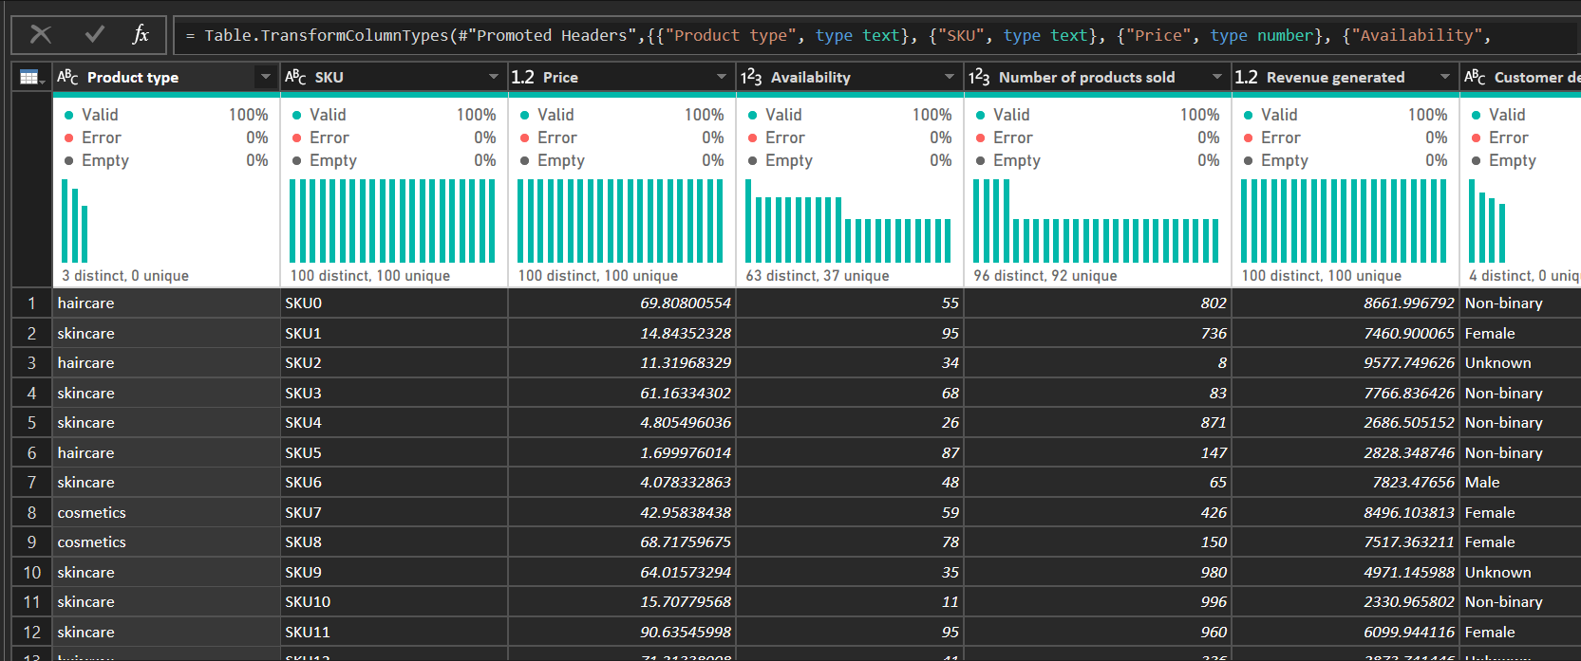
Page 006
Data
Cleaning
Before

Slide 7
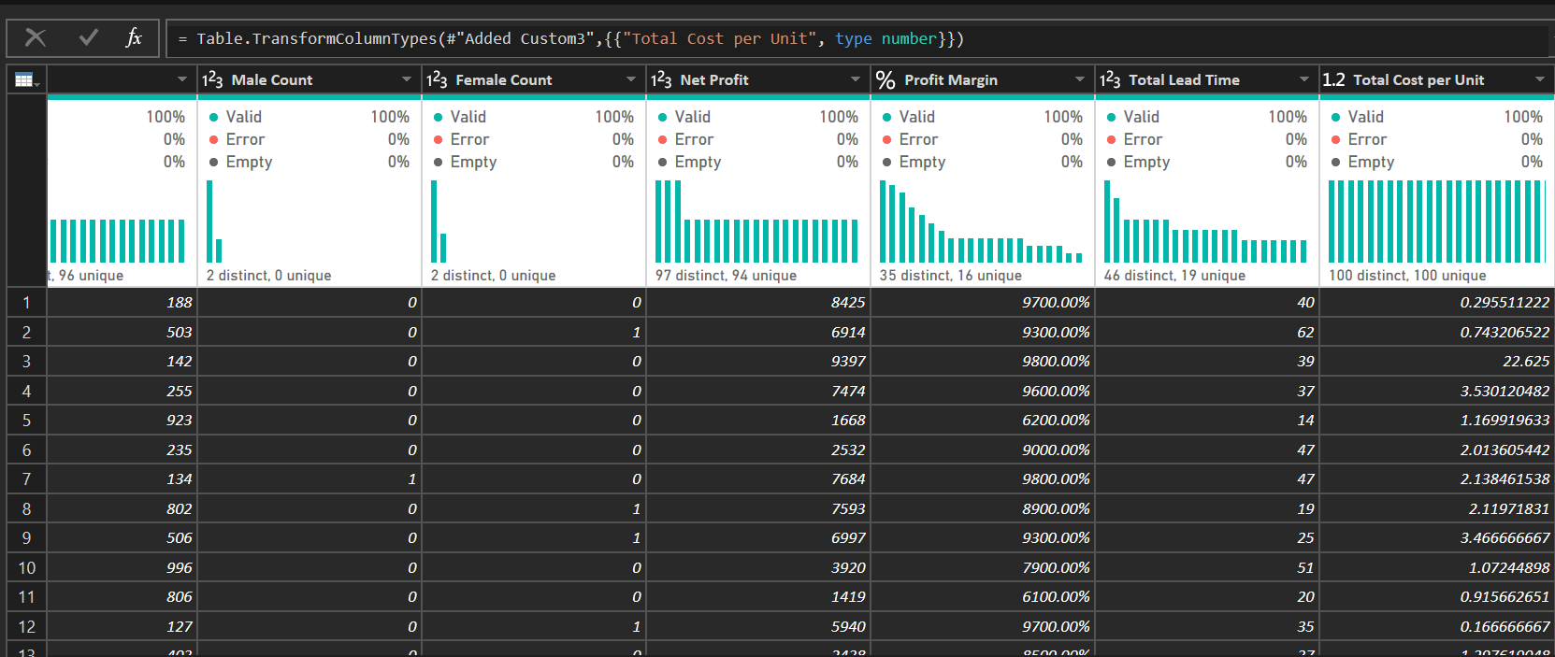
Page 007
Data
Cleaning
After

Slide 8
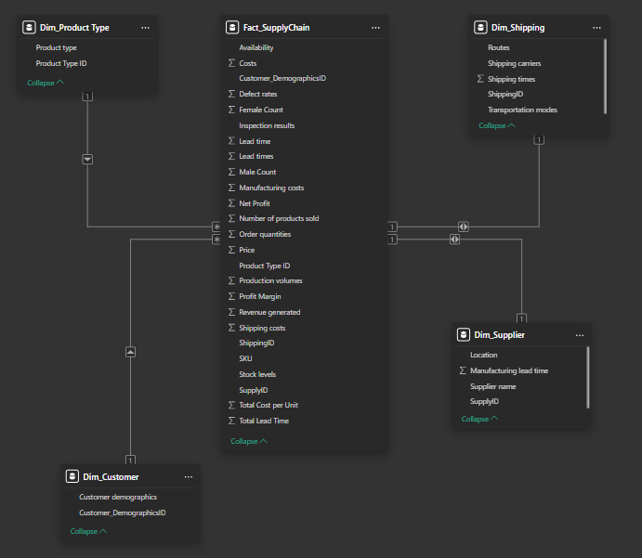
Page 008
Data
Modeling

